Slide 1
Sprint 3 Delivery
Group 1 - Alex, Angel, Atanas, Stoyan, Tsanko
Notes:
Goal of the sprint:
Improve performance
look into a time series database
work on summary tables and events for inserting
finish alerting.
All are on 90%

Slide 2
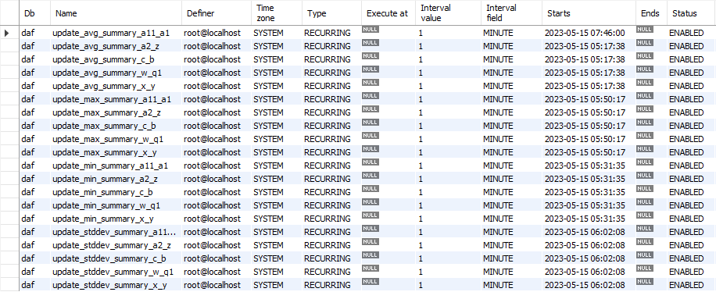
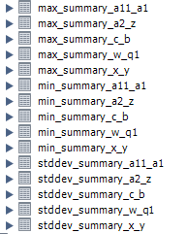
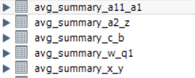
Summary Tables and Events

Slide 3
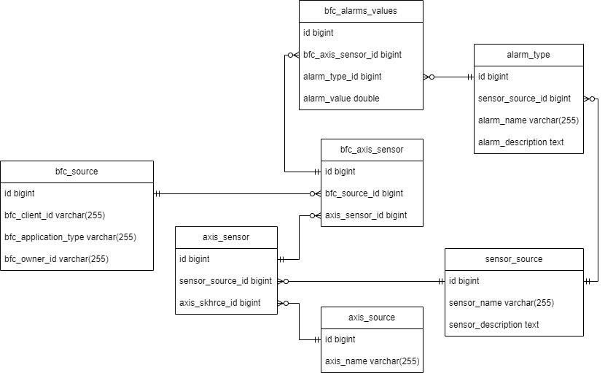
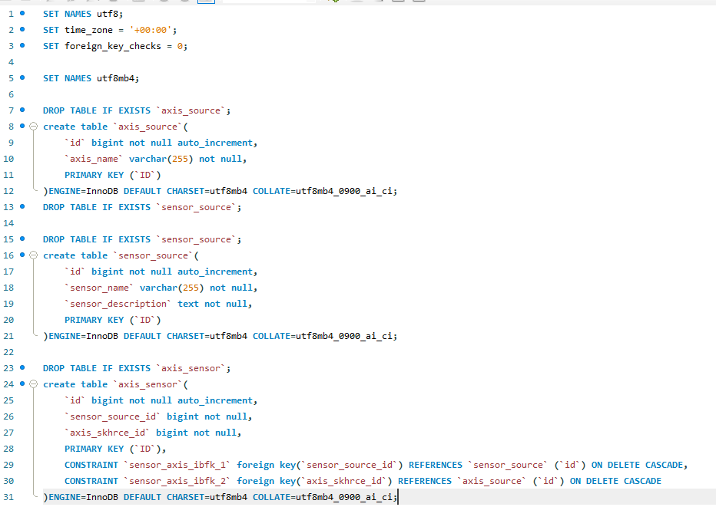
Alarm Alerting Update

Slide 4
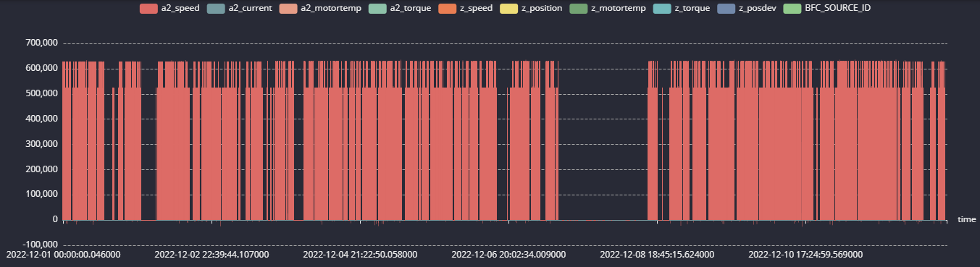

QuestDB
45s to visualize
Supports SQL

Slide 5
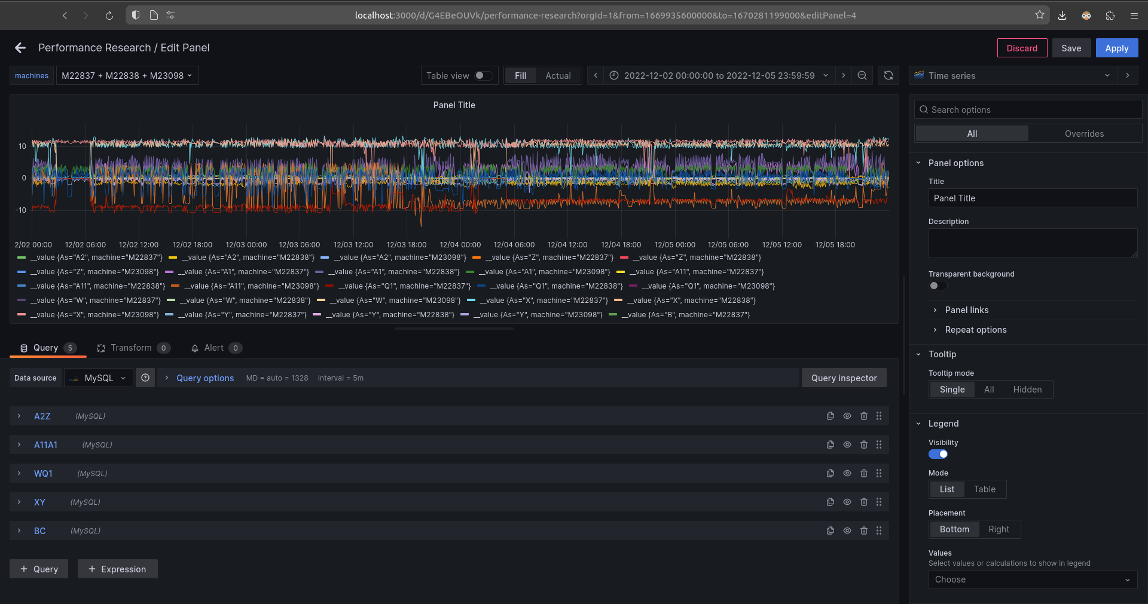
Query per table (2 axes)

Slide 6
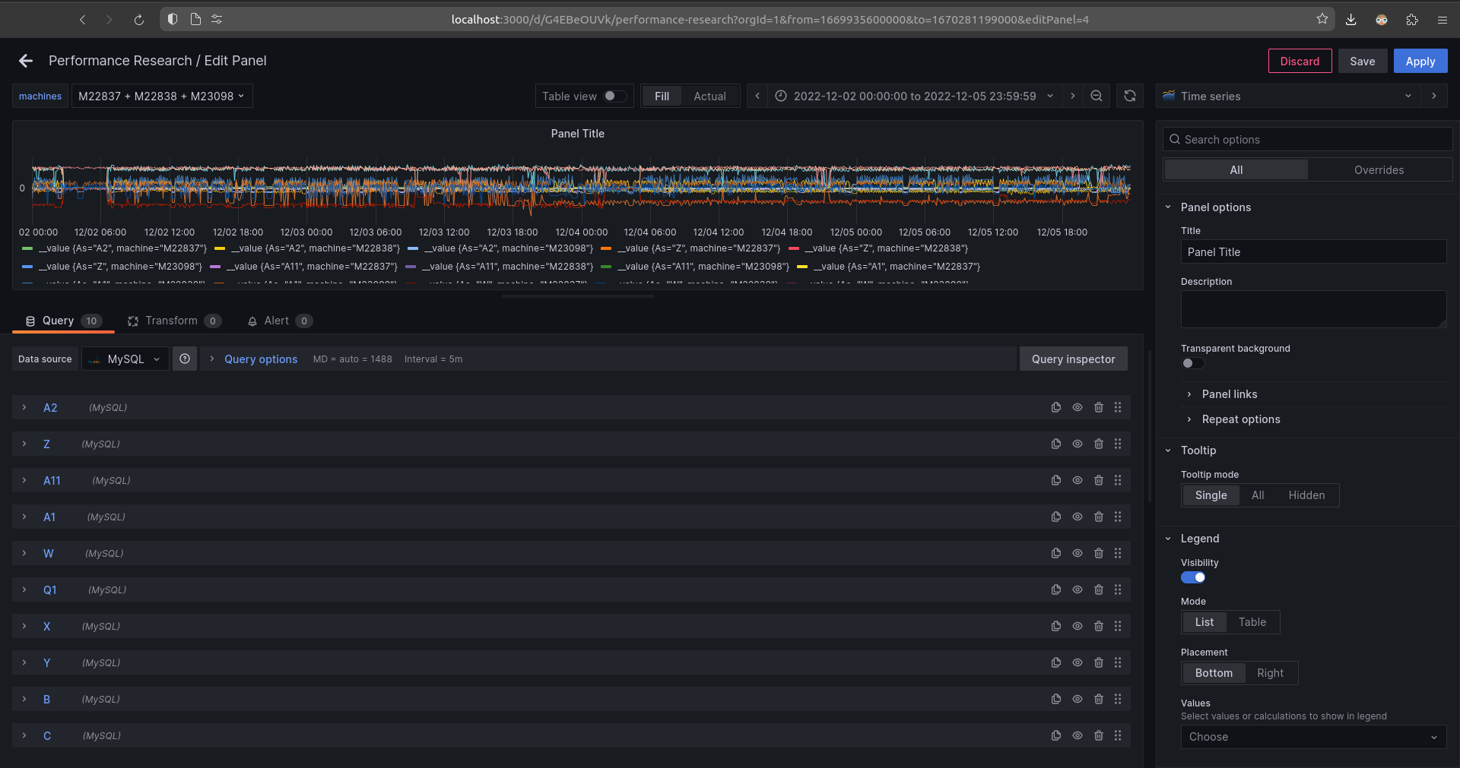
Query per axis

Slide 7
Comparison
Run | Baseline [s] | Per Table [s] | Per axis [s]
1 |  | 41.0 | 79.8
2 |  | 41.0 | 79.8
3 |  | 41.0 | 80.4
Average | 83.0 | 41 | 80

Slide 8

What’s next?
Notes:
Finish tasks this week and hand over deliverables
Alert selection queries

Slide 9
Thank you for your time

